Slide 1

Cloud Security and Forensics
Kernel Based Virtual Machine and Xen
Dr. Raj K Jaiswal

Slide 2
What is KVM?
Kernel-based Virtual Machine (KVM) is a software feature that can be installed on physical Linux machines to create virtual machines.
A virtual machine is a software application that acts as an independent computer within another physical computer.
It shares resources like CPU cycles, network bandwidth, and memory with the physical machine.
KVM is a Linux operating system component that provides native support for virtual machines on Linux. It has been available in Linux distributions since 2007.

Slide 3
Why is KVM important?
Kernel-based Virtual Machine (KVM) can turn any Linux machine into a bare-metal hypervisor.
This allows developers to scale computing infrastructure for different operating systems without investing in new hardware.
KVM frees server administrators from manually provisioning virtualization infrastructure and allows large numbers of virtual machines to be deployed easily in cloud environments.

Slide 4
Advantages of KVM
High performance
KVM is engineered to manage high-demanding applications seamlessly.
All guest operating systems inherit the high performance of the host operating system—Linux.
The KVM hypervisor also allows virtualization to be performed as close as possible to the server hardware, which further reduces process latency.
Security
Virtual machines running on KVM enjoy security features native to the Linux operating system, including Security-Enhanced Linux (SELinux).
This ensures that all virtual environments strictly adhere to their respective security boundaries to strengthen data privacy and governance.

Slide 5
Advantages of KVM
Stability
KVM has been widely used in business applications for more than a decade.
It enjoys excellent support from a thriving open-source community.
The source code that powers KVM is mature and provides a stable foundation for enterprise applications.
Cost efficiency
KVM is free and open source, which means businesses do not have to pay additional licensing fees to host virtual machines.
Flexibility
KVM provides businesses many options during installations, as it works with various hardware setups.
Server administrators can efficiently allocate additional CPU, storage, or memory to a virtual machine with KVM.
KVM also supports thin provisioning, which only provides the resources to the virtual machine when needed.

Slide 6
How does KVM work?
Kernel-based Virtual Machine (KVM) requires a Linux kernel installation on a computer powered by a CPU that supports virtualization extensions.
Specifically, KVM supports all x86 CPUs, a family of computer chips capable of processing the Intel x86 instruction language.
Linux kernel
Linux kernel is the core of the open-source operating system.
A kernel is a low-level program that interacts with computer hardware.
It also ensures that software applications running on the operating system receive the required computing resources.
Linux distributions, such as Red Hat Enterprise Linux, Fedora, and Ubuntu, pack the Linux kernel and additional programs into a user-friendly commercial operating system.

Slide 7
How does KVM work?
How to enable KVM
Once you have installed the Linux kernel, you need to install the following additional software components on the Linux machine:
A host kernel module
A processor-specific module
An emulator
A range of other Linux packages for expanding KVM’s capabilities and performance
Once loaded, the server administrator creates a virtual machine via the command line tool or graphical user interface. KVM then launches the virtual machine as an individual Linux process. The hypervisor allocates every virtual machine with virtual memory, storage, network, CPU, and resources.

Slide 8
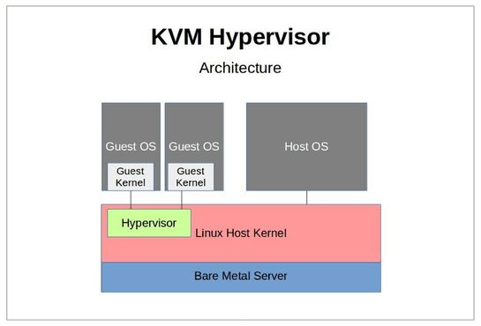

Slide 9
Xen hypervisor
Xen is a type 1 hypervisor that creates logical pools of system resources so that many virtual machines can share the same physical resources.
Its is a hypervisor that runs directly on the system hardware.
It inserts a virtualization layer between the system hardware and the virtual machines, turning the system hardware into a pool of logical computing resources that Xen can dynamically allocate to any guest operating system.
The operating systems running in virtual machines interact with the virtual resources as if they were physical resources.

Slide 10
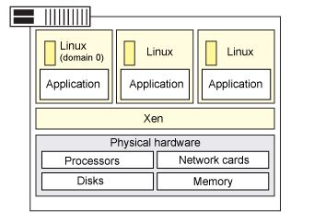
Xen hypervisor
Features: The following are key concepts of the Xen architecture:
Full virtualization.
Xen can run multiple guest OS, each in its on VM.
Instead of a driver, lots of great stuff happens in the Xen daemon, xend.

Slide 11
VMWare ESXI
VMware ESXi is the bare-metal hypervisor in the VMware vSphere virtualization platform.
VMware ESXi runs on top and access the hardware directly without the need to install an operating system.
This direct access to hardware allows it to perform better, run faster and be more scalable than other types of hypervisors.
The VMware ESXi architecture mainly consists of VMkernel and the processes.
VMkernel is technically an operating system.
Like other operating systems, VMkernel creates and controls processes, controls hardware devices on the server.
It uses a file system, manages application resources.
Its main function is to support virtual machines.

Slide 12
VMware ESXi Features
Small size
At just 150 MB, Vmware touts ESXi as the world’s smallest hypervisor. A small footprint often means a reduced attack surface from outside threats, aside from easier maintainability.
Convenient installation
With its small size, faster installation is possible. You can even boot up ESXi from a USB flash drive.
User-friendly administration tools
ESXi offers a built-in, HTML5-compliant browser for administrative use. Organizations that require automated operations can also utilize the vSphere Command Line Interface for remote management and application programming interfaces (APIs) based on Representational state transfer (REST).

Slide 13
Secure design
The data that exists in your VMs are secure due to built-in encryption. Add role-based access plus extensive logging and auditing capabilities.
Scalable reliability
No matter your application requirements, a single ESXi hypervisor can be configured to run as many as 128 virtual CPUs and 120 devices on 6 TB of memory.
Extensive support and compatibility
ESXi’s popularity as an enterprise platform means wide support from hardware vendors and application partners, as well as compatibility with a broad range of applications and guest operating systems.

Slide 14
Hyper V
Hyper-V is virtualization software that, well, virtualizes software.
It cannot only virtualize operating systems but also entire hardware components, such as hard drives and network switches. Unlike Fusion and Virtualbox,
We can use it for server virtualization, too.
Hyper-V is available in three versions.
Hyper-V for Windows Servers
Hyper-V Servers
Hyper-V on Windows 10

Slide 15
Bare metal server
Bare metal servers are a form of cloud services in which the user rents a physical machine from a provider that is not shared with any other tenants.
Unlike traditional cloud computing, which is based on virtual machines, bare metal servers do not come with a hypervisor pre-installed and give the user complete control over their server infrastructure.
With a bare metal server, users get complete control over the physical machine, they have the flexibility to choose their own operating system, avoid the “noisy neighbor” challenges of shared infrastructure, and finely tune hardware and software for specific, often data-intensive, workloads.
Along with virtual machines, networking, and storage, bare metal servers are a foundational component of the IaaS stack in cloud computing.

Slide 16
Benefits of bare metal servers
The primary benefits of bare metal servers are based on the access end users have to hardware resources.
Enhanced physical isolation and the associated security and regulatory benefits
Greater processing power
Complete control of their software stack
More consistent disk and network I/O performance
Greater quality of service (QoS) by eliminating the noisy neighbor phenomenon

